Slide 1


Keyur Makwana
6th July 2022

Slide 2

Outline
Executive Summary
Introduction
Methodology
Results
Conclusion
Appendix

Slide 3

Executive Summary
Summary of methodologies
Data Collection through API
Data Collection with Web Scraping
Data Wrangling
Exploratory Data Analysis with SQL
Exploratory Data Analysis with Data Visualization
Interactive Visual Analytics with Folium
Prediction through different Machine Learning Techniques
Summary of all results
Exploratory Data Analysis Result
Interactive analytics in Screenshots
Predictive Analytics Result

Slide 4

Introduction
Project background and context
SpaceX advertises Falcon 9 rocket launches on its website with a cost of 62 million dollars; other providers cost upward of 165 million dollars each, much of the savings is because SpaceX can reuse the first stage. Therefore if we can determine if the first stage will land, we can determine the cost of a launch. This information can be used if an alternate company wants to bid against SpaceX for a rocket launch.
Problems to find answers
Will the rocket land successfully in the first stage?
Can the rocket be reused after the first stage?
Which conditions satisfy the successful launch?

Slide 5

Section 1

Slide 6

Methodology
Executive Summary
Data collection methodology:
Python request library is used to collect the data from SpaceX wikipedia website
Perform data wrangling
Data was preprocessed & transformed into standard scaler for machine learning prediction algorithms
Perform exploratory data analysis (EDA) using visualization and SQL
Various graphs like scatter plot & bar graphs along with SQL EDA helped to show the nature of data
Perform interactive visual analytics using Folium and Plotly Dash
Interactive Plotly dashboard relates launch site with success ratio using pie chart & scatter plot
Perform predictive analysis using classification models
Built various algorithms & fine tuned them by finding best hyperparameter

Slide 7
Data Collection
Data sets were collected using SpaceX Rest APIs
Rockets (https://api.spacexdata.com/v4/rockets), Payloads (https://api.spacexdata.com/v4/payloads)
Launchpad (https://api.spacexdata.com/v4/launchpads)
Falcon 9 heavy launches data collected by wikipedia site using webscrapping
https://en.wikipedia.org/wiki/List_of_Falcon_9_and_Falcon_Heavy_launches
SpaceX Rest
API Call
JSON Response
Convert
Dataframe
Clean & export data
Wikipedia HTTP Response
Extract Data
BeautifulSoup
Convert
Dataframe
Clean & export data

Slide 8
Data Collection – SpaceX API
We used public API of SpaceX. We have obtained data by HTTP get method. We performed data wrangling & formatting to clean & export data
Code Link : SpaceX API
Collect Data Through HTTP GET request
Convert Response in JSON
Process & Transform Data
Convert to Dataframe
Export to CSV file

Slide 9
Data Collection - Scraping
We used wikipedia website of SpaceX. We have obtained data, processed & transformed using BeautifulSoup library. We parsed through tables-columns to get data & converted into dataframe & export data
Code Link : SpaceX WebScrapping
Collect Data Through HTTP GET request (Wikipedia)
Normalize response & Convert in JSON
Process & Transform Data
Using BeautifulSoup
Convert to Dataframe
Export to CSV file

Slide 10
Data Wrangling
Load Data
Calculating Landing Outcomes
EDA helped to find some patterns in the data and determine what would be the label for training supervised models
In the dataset through EDA we can summarize how many launches happened from different launch sites, in which orbit they launched & the success ratio for each launch & launch sites
Code Link : Data Wrangling
Finding Good & Bad Outcomes
Converting Outcomes in binary format
Updating Dataframe with outcomes
Export Data to CSV

Slide 11
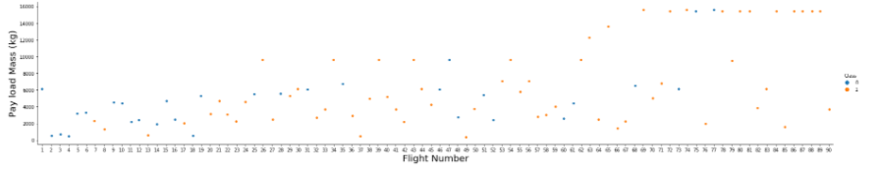
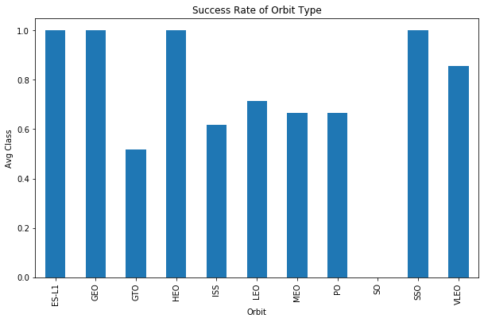
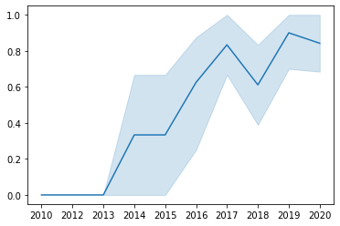
EDA with Data Visualization
Scatter plot chart to show successful launches by comparing flights & payload mass
Bar chart shows success rate per orbit type
Success rates of the launches over the years
Code Link : EDA Visualization

Slide 12
EDA with SQL
EDA with SQL helps Data Scientists to analyze the data & give insights of overall dataset. It helps Data Scientists to see through the data & help in making decision on which data to manipulate & in what way. We derived below insights by performing EDA through SQL
Display the names of the unique launch sites in the space mission
Display of the booster versions which have carried the maximum payload mass.
Display of the failed landing outcomes in drone ship, their booster versions, and launch site names for in year 2015
Ranked the count of landing outcomes (such as Failure (drone ship) or Success (ground pad)) between the date 2010-06-04 and 2017-03-20, in descending order
Code Link : EDA SQL

Slide 13
Build an Interactive Map with Folium
Map objects & reason to add:
Folium.map : Creates a custom pane to hold map elements which is centered to country USA where all spaceX launches happened
Folium.map.marker : Create a simple stock Leaflet marker on the map, with optional popup text or Vincent visualization. It helped to mark different launch sites on the map
Folium.circle : Class for drawing circle overlays on a map. It helped to ma the areas of different launch sites.
Folium.polyline : Draw polygon overlays on a map. It helped to measure distance from launch site to nearest city, railway line, coastlines.
Code Link : Site Locations

Slide 14
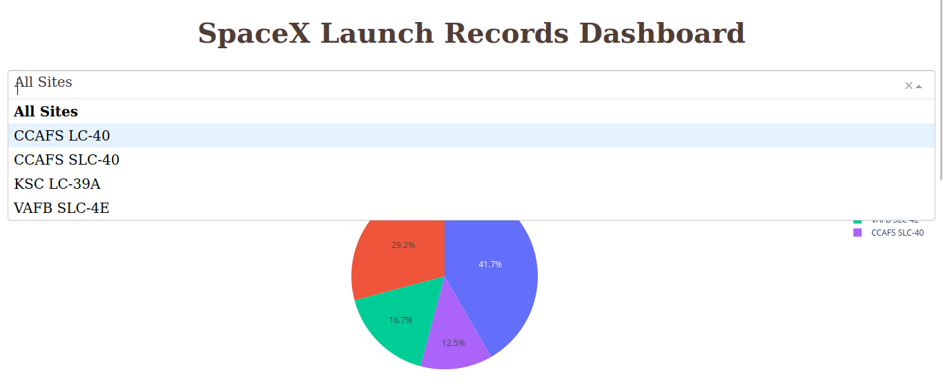
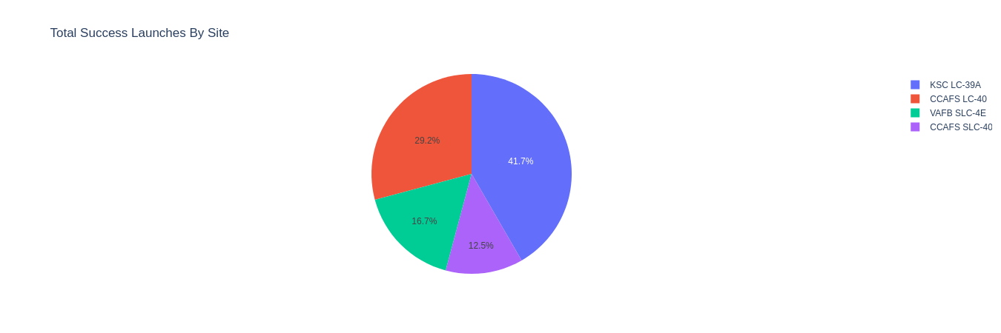
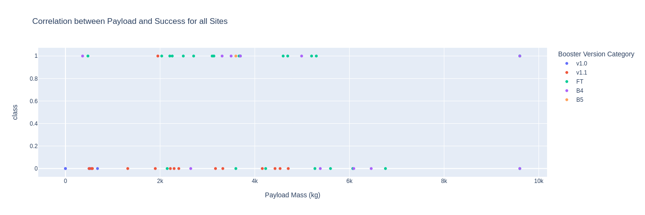
Build a Dashboard with Plotly Dash
Display all launch sites in dropdown to analyze them individually or collectively
Successful launches from all launch sites on pie chart
Scatter plot shows correlation between payload mass and success for all sites
Code Link : SpaceX Dashboard

Slide 15
Predictive Analysis (Classification)
We first loaded the data from CSV file for both training & testing purpose
We transformed the data & splitted using StandardScaler() of sklearn's preprocessing library
We have fitted the training data to 4 different machine learning algorithms which were Logistic Regression, SVM, Decision Tree & K-nearest neighbor
We have found best hyperparameter for each algorithm using GridsearchCV which is cross validation method
We have evaluated model by different test score methods for each model
Code Link : Predictive Analysis

Slide 16
Results
Exploratory data analysis results
Interactive analytics demo in screenshots
Predictive analysis results

Slide 17

Section 2

Slide 18
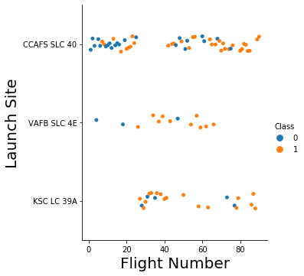
Flight Number vs. Launch Site
This scatter plot shows success ratio with the increase of flight numbers at a specific launch site

Slide 19
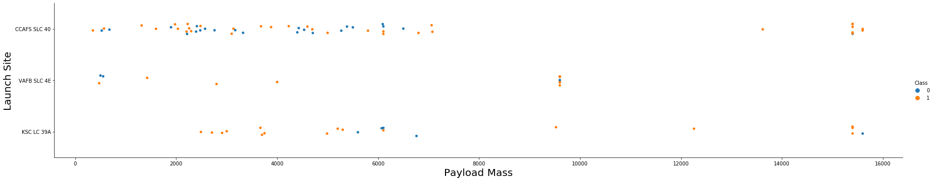
Payload vs. Launch Site
This scatter plot shows us with increase of payload weight the success rate increases for locations KSC LC 39A and VAFB SLC 4E.
We can also see almost 100% success rate at site CCAF5 SLC 40 for payload more than 7000.

Slide 20
Success Rate vs. Orbit Type
This bar chart shows orbit types ES-L1, GEO, HEO, SSO & VLEO have higher success rate than other orbit types

Slide 21
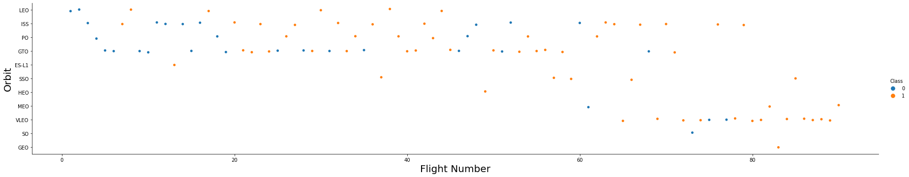
Flight Number vs. Orbit Type
This bar chart shows that with increase of flight number success rate is also increased for some orbit types

Slide 22
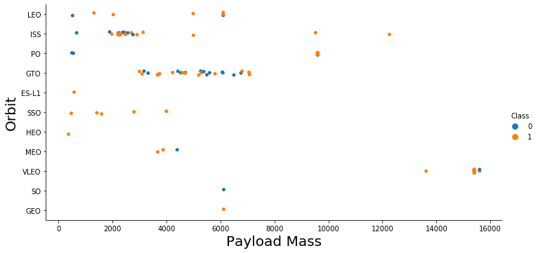
Payload vs. Orbit Type
This scatter plot suggests if the payload mass is between 100 to 4000 then SSO, HEO, ES-L1 are proven effective

Slide 23
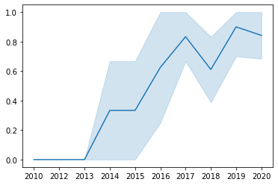
Launch Success Yearly Trend
This line chart shows the success rate of each launch has succeed over the years, specially after 2013

Slide 24
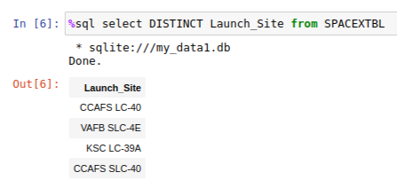
All Launch Site Names
Distinct in query gives unique result to be applied on query
We gathered unique Launch site names using Distinct keyword on column Launch_Site

Slide 25
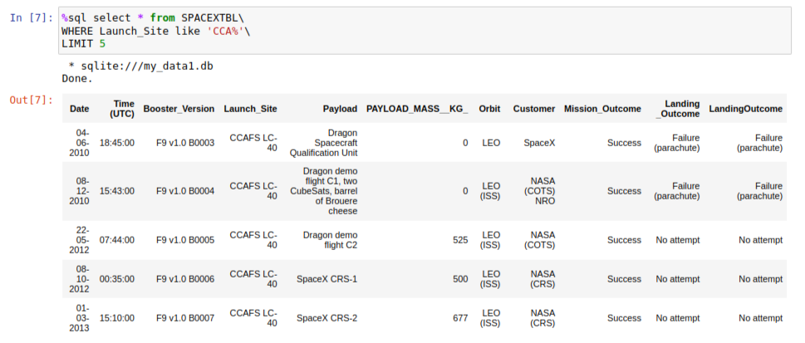
Launch Site Names Begin with 'CCA'
"Like" operator matches similar records with given letters
Using "like" operator we have filtered records whose Launch Site starts with letters 'CCA'

Slide 26
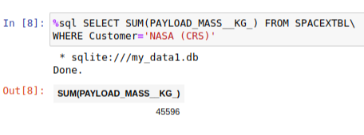
Total Payload Mass
We got total payload mass in KG by Sum keyword in sql query

Slide 27
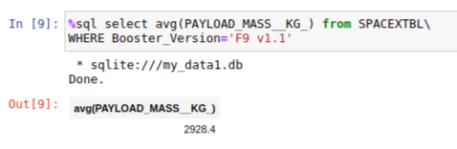
Average Payload Mass by F9 v1.1
We used avg keyword to get average payload mass of Booster version F9 v.1

Slide 28
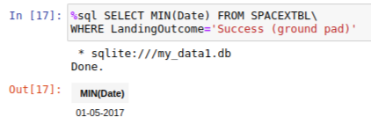
First Successful Ground Landing Date
We used "min" keyword in sql query to get first successful ground landing date

Slide 29
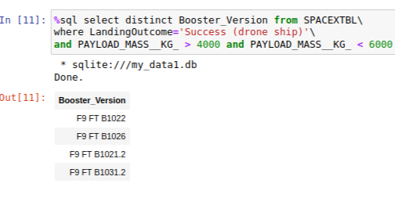
Successful Drone Ship Landing with Payload between 4000 and 6000
By above sql query we get unique booster versions. It is important to note that we've added multiple conditions in where clause to get the expected result

Slide 30
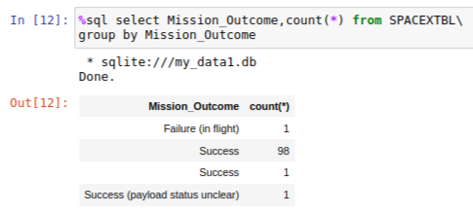
Total Number of Successful and Failure Mission Outcomes
In this sql query we used count & group by together to get total no. Of successful & failure mission outcomes

Slide 31
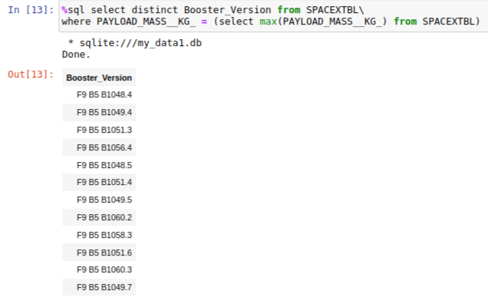
Boosters Carried Maximum Payload
With max subquery & distinct in the main query we found out maximum payload carried out by different booster versions

Slide 32
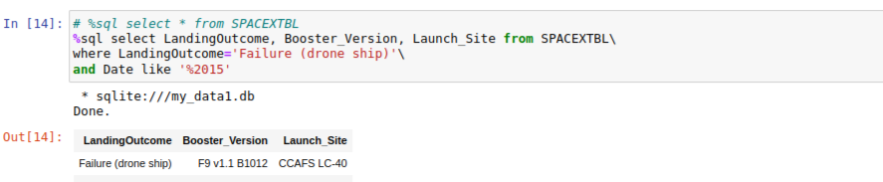
2015 Launch Records
We've filtered records of 2015 with like operator

Slide 33
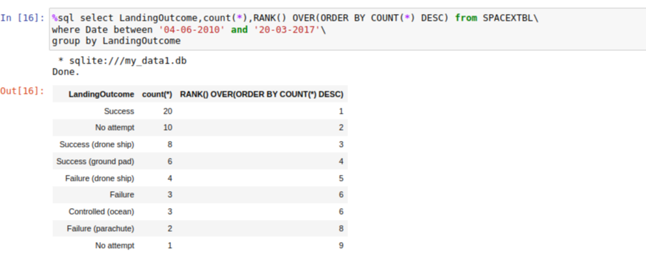
Rank Landing Outcomes Between 2010-06-04 and 2017-03-20
We have used rank over sql function to give rank of landing outcomes between 2010-06-04 and 2017-03-20

Slide 34

Section 3

Slide 35
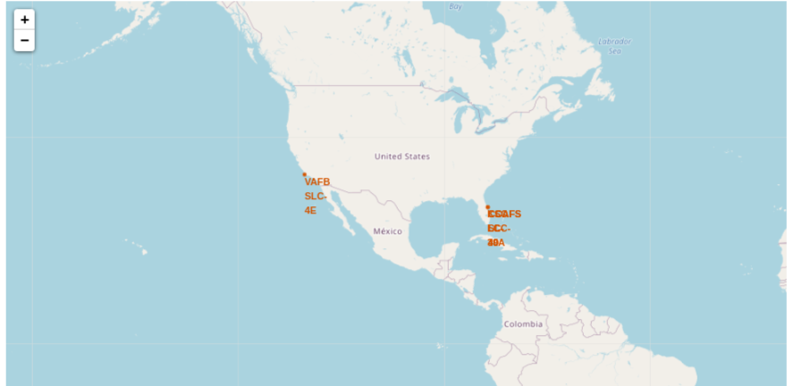
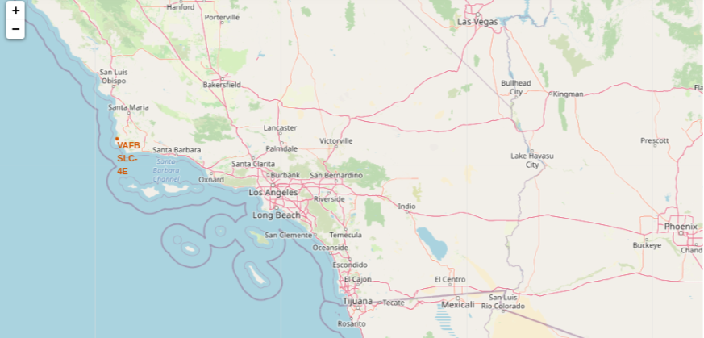
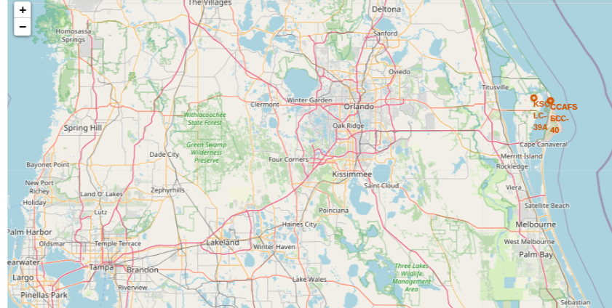
All Launch Sites Location on Map
We can see launch sites on 2 different coasts of USA
Above launch site we can see on west coast
Above launch site we can see on east coast

Slide 36
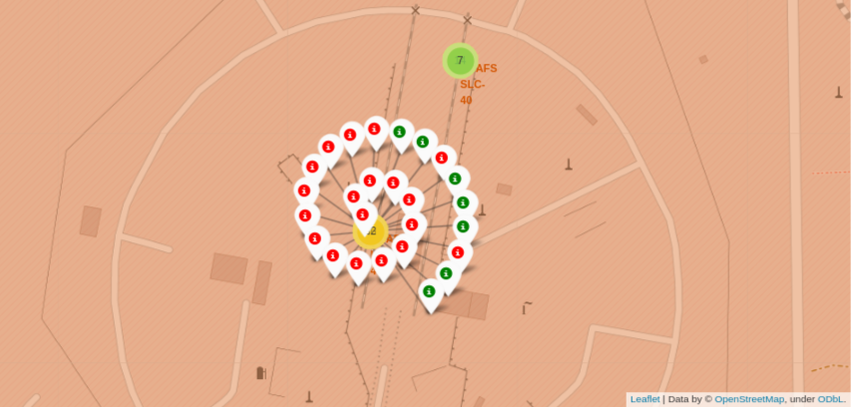
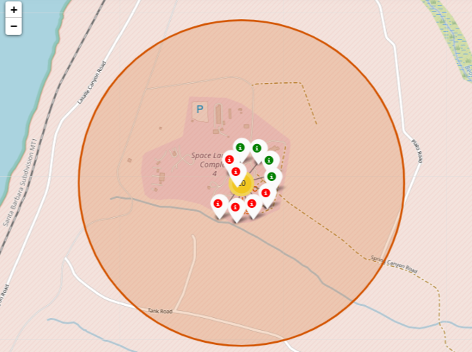
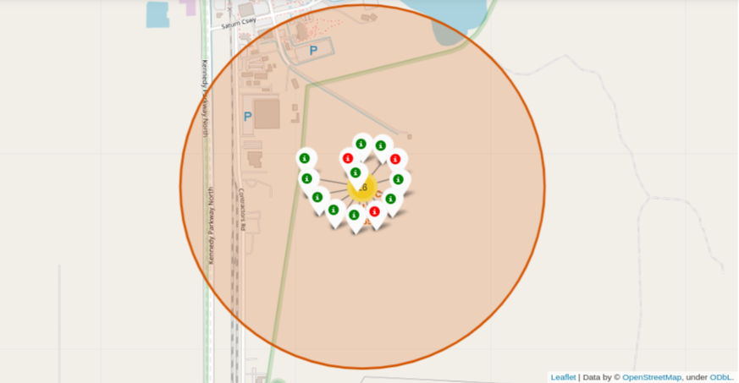
Launch outcomes with color labeled
We can see launching outcomes in different coded system, green suggests the outcome is successful whereas red suggest the outcome was a failure
We can see highest success rate of launch than any other launch site at site KSC LC-39A
We can see launch site CCAFS LC-40 has more failed outcomes than successful ones
We can see the success ratio is 50% for Launch Site VAFB SLC-4E

Slide 37
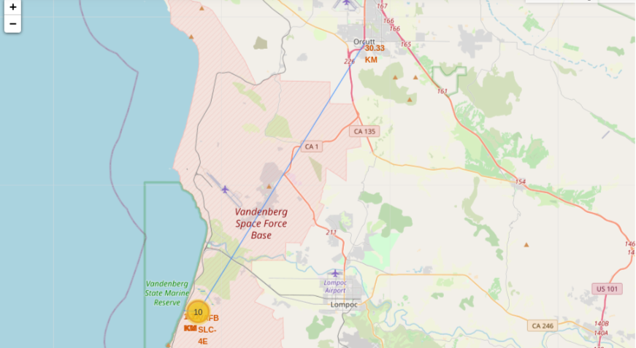
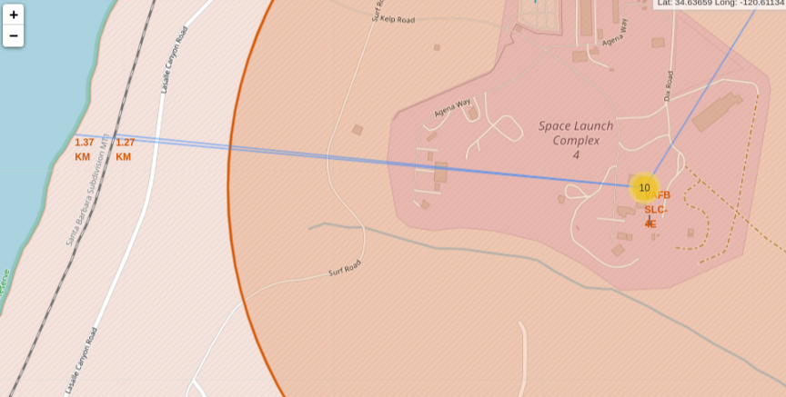
Coastline, Railway & City distance to Launch Site
We can see the nearest city is about 33 KM from the launch site
We can see the nearest coastline & railway line from the launch site
It is very important to know the nearest city, railway lines, coast lines to the launch site. Payload sometimes are heavy in weight & only means of transportation could be via maritime or railway

Slide 38

Section 4

Slide 39
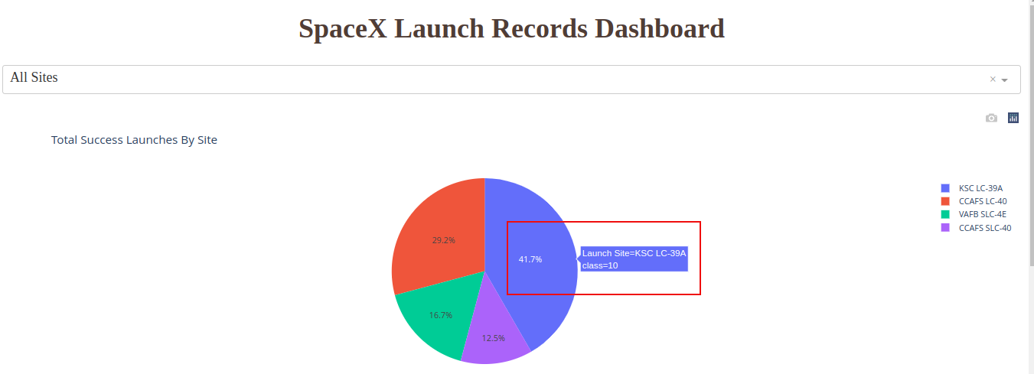
Dashboard – Launch Success Pie Chart
In above pie chart we can see launch site KSC LC-39A has highest success rate

Slide 40
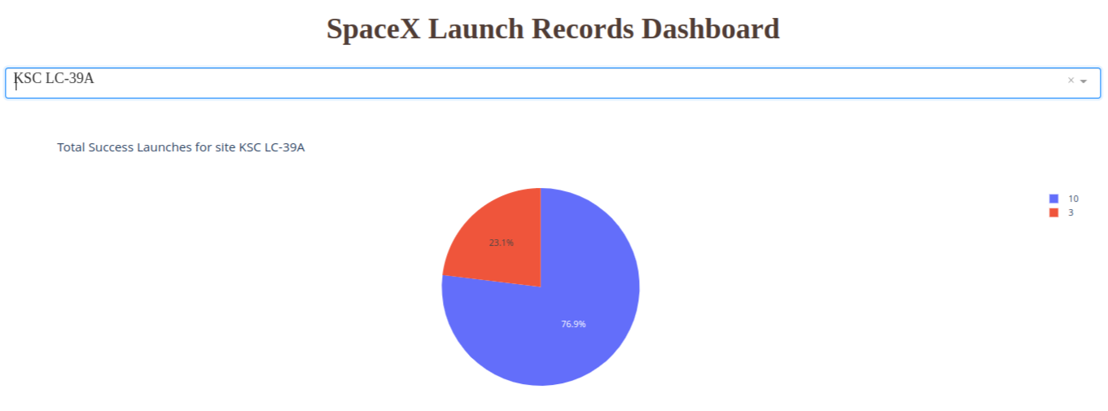
Dashboard – Best Launch Site
As we can see KSC LC-39A has the highest success rate of 76.9% among all other launch sites

Slide 41
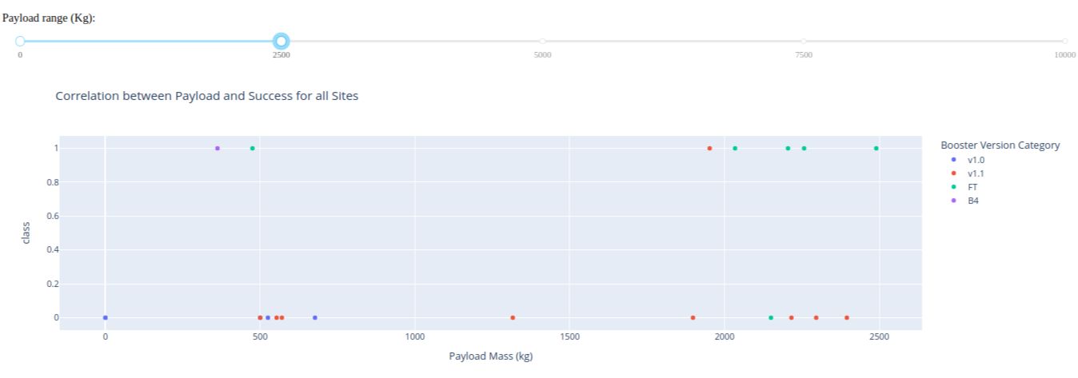

Dashboard – Payload vs. Outcome Scatter Plot
We can see in above scatter plot, the outcome was failure for booster version 1.1 when payload is 0-2500 KG in weight
In above scatter plot we can see booster version FT has higher success rate when payload weight is between 2000-5500 KG

Slide 42

Section 5

Slide 43
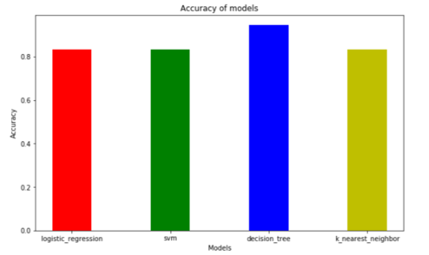
Classification Accuracy
We have trained & tested Logistic Regression, SVM, Decision Tree & K-Nearest Neighbor models.
Among them we have found highest accuracy with Decision Tree model with 94%

Slide 44
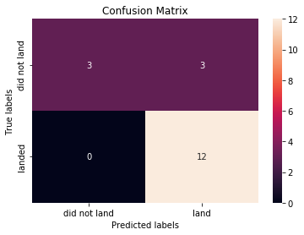
Confusion Matrix
In the above Confusion Matrix of Decision Tree model we can see we predicted landing outcomes with high success rates, the failure outcomes prediction we can see is 100%

Slide 45
Conclusions
By EDA we revealed hidden insights like orbit type plays important role in successful launch
We also covered the relation between payload weight & booster versions
We can also see that after year 2013 the success of launches has been increasing
Out of SVM, Logistic Regression, Decision Tree & K-Nearest Neighbor models we trained & tested them & the best accuracy we got with Decision Tree
KSC LC-39A proved to have most successful launches than any other launch sites
Orbit type ES-L1, GEO, HEO & SSO have the best success rate

Slide 46
Appendix
Github link : https://github.com/keyur077/IBM_DS_Capstone

Slide 47


